Slide 1


MoodSync
AI-Powered Mood-Based Music Recommendation

Slide 2
Moodify
AI-Powered Mood-Based Music Recommendation

Slide 3






Upgrade
MoodSync
Welcome
About Us
Our Teams
Our Teams
Agenda
Our Services
Achievements
Our Goals
Gallery
Pricing
Contact Us
Kevin Joseph
Hemanth S
Abbas Ibrahim
Pavas K

Slide 4
End-to-End Flow
What is Moodify?
01
AI-powered real-time mood detection
"Music speaks when words fail. MoodSync translates emotions into music, creating a seamless listening experience that speaks to the heart—without a single spoken word."
Personalized music recommendations based on facial expression, playlist history, and social music trends.
02
03
A truly adaptive music experience, evolving with your emotions.

Slide 5
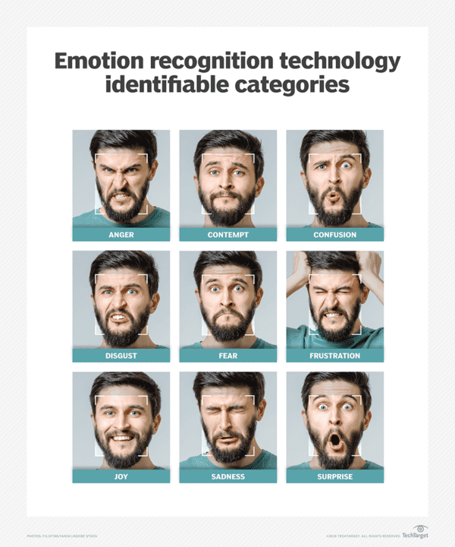
End-to-End Flow
Step1- Detect Mood Using AI
MoodSync's advanced AI technology leverages real-time facial expression analysis to ensure accurate mood detection, forming a critical basis for personalized music experiences that resonate with users' emotional states.

Slide 6
Step2- AI-Driven Playlist Curation
Personalized Playlist Creation
Real-Time Mood Adaptation
Therapeutic Music Applications
🎵 Analyzes user data and emotional states to generate playlists.
🎯 Aligns playlists with individual preferences and current moods.
🚀 Enhances the listening experience through AI-driven personalization.
🏥 Therapeutic Use: MoodSync’s curated playlists can be utilized in therapy.
💡 Aids emotional regulation and mental well-being.
🎧 Enhances targeted musical interventions for stress relief and relaxation.
🔄 Continuously updates playlists based on immediate emotional feedback.
🎶 Ensures music selections remain relevant to users' emotional journeys.

Slide 7
Why Moodiy Matters?
Personalized Music: Tailors playlists to the user's mood for a more engaging experience.
Emotional Well-Being: Helps users manage emotions by suggesting music that uplifts, relaxes, or matches their feelings.
Cutting-Edge Tech: Leverages face recognition and deep learning for real-time mood detection.
Instant & Seamless: Adapts to daily life, offering immediate music suggestions based on mood.
Enhanced Music Discovery: Exposes users to new genres and tracks based on emotional states.
Supports Mental Health: Aids in emotional regulation and overall well-being through music therapy.

Slide 8

Recorded Demo

Slide 9
Conclusion
Why MoodSync is a Game-Changer?
✅ Bridges AI & Music – Real-time emotional adaptation.
✅ Scales beyond entertainment – Into productivity, therapy, and smart environments.
✅ Revolutionizes personalization – Moves beyond basic recommendations to emotion-based music curation.
What’s Next?
🎵 Mobile app launch (iOS/Android)
🏠 Integration with smart devices (Alexa, Apple HomePod)
🧠 AI-powered mental wellness playlists
"MoodSync is more than just music—it’s emotional communication beyond words."

Slide 10
Thank You
MoodSync
AI-Powered Mood-Based Music Recommendation

